Slide 1

67 Capital Ltd
South-South Nigeria
Profit and Loss Statement Financial
Analysis
Love Friday

Slide 2
Objective
Analyze Profit & Loss data to understand revenue, expenses, and overall profitability across the South-South branches.
Have a clear picture of each branch’s financial health and actionable insights to improve performance.

Slide 3
Process
Understanding the data
Data Transformation & Modeling
Data Analysis
Data Visualization
Insights & Recommendations

Slide 4
Dataset- Overview
The dataset for this project was gotten from 67Capital Ltd dataset.
It contains 40,000 rows of transaction carried out between 2020 and 2023 by the bottle water company branches in the South-South region (Akwa-Ibom, Bayelsa, Cross River, Delta, Edo and Rivers) of Nigeria.
It also has the following fields explaining each transaction:
Date: The date of the financial transaction.
Branch: The name of the branch where the transaction occurred.
Account Category: The category of the account (e.g. Revenue , Expenses).
Account Name: The specific account associated with the transaction (e.g. Salaries, Loan Income).
Amount (NGN): The monetary amount of the transaction, in Nigeria Naira.

Slide 5
Data Transformation & Modelling
Data Cleaning Stages in Ms Excel
The amount column was formatted to show the exact currency(NGN).
Using nested IF functions in Excel, transactions from the Account Category column were grouped into two categories: Revenue and Expenses. Categories such as Other Expenses, Revenue, Cost of goods sold, Depreciation & Amortization, Operating Expenses, and Other Income were classified accordingly in a new column named Transaction Type.
=IF(C2="OtherExpenses","Expenses",IF(C2="OtherIncome","Revenue",IF(C2="Revenue","Revenue",IF(C2="Cost ofGoods Sold","Expenses",IF(C2="Depreciation and Amortization","Expenses",IF(C2="Operating Expenses","Expenses",0))))))
Data Modelling in Power BI
Imported the dataset into Power BI for further analysis
To enhance data analysis, I utilized time intelligence to create a new “Calendar” Table, which includes key time dimensions: year, month, and quarter. This structure enables deeper insights by simplifying time-based aggregations and calculations.
I modeled the calendar table alongside the financial dataset, establishing a one-to-many relationship between the two. This setup provided a robust foundation for the subsequent data visualization process, enabling more efficient exploration and interpretation of time- based trends.

Slide 6
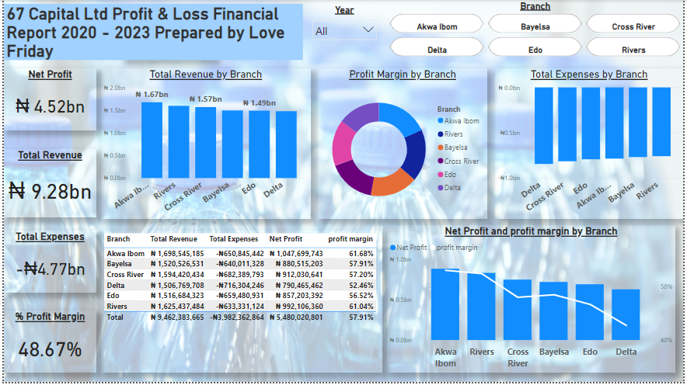
Insights
The south-south branches of 67 Capital Ltd generated 9.28bn NGN in revenue and utilized 4.77bn NGN in expenses, with a Net Profit of 4.52bn NGN which is a 48.67% profit margin in the space of 4 years, indicating a healthy market/business for the company in the region.
The Akwa Ibom branch generated the most revenue for the company, followed by Rivers with the least being Delta.
Delta also had the highest Expenditure within the region.

Slide 7
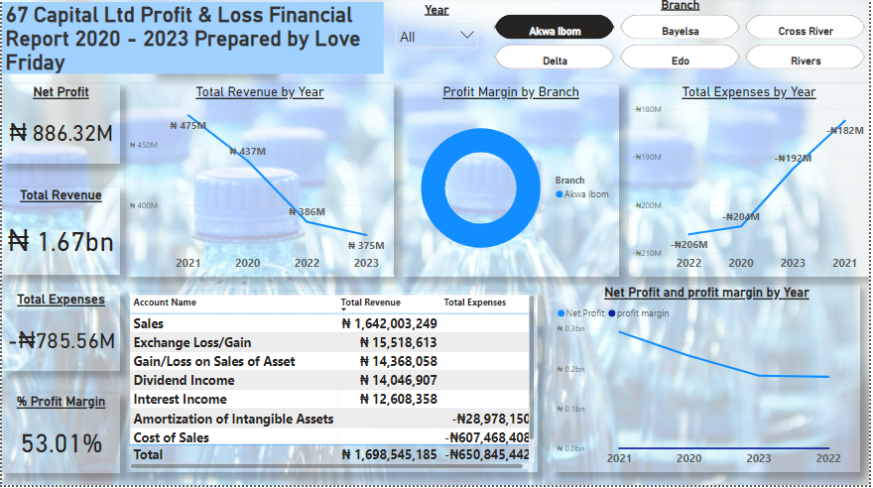
Insights
Akwa Ibom had their best year in 2021 generating over 470M NGN in revenue and utilizing below 200M NGN in expenditure with a profit margin of 53.01%.
They experienced a sharp decline in revenue in the following years which raises concern.
The main source of revenue was Sales as it is with other branches while majority of the expenditures were on Cost of Sales i.e. cost of producing the goods sold.

Slide 8
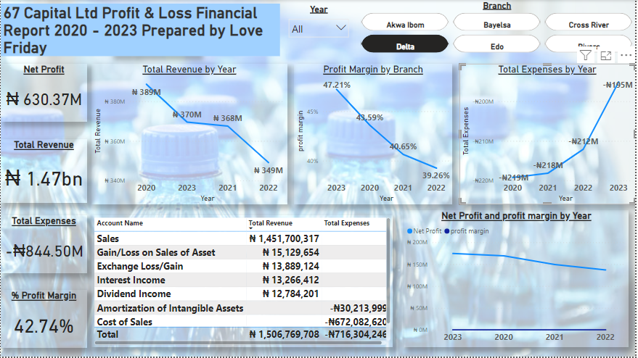
Insights
Delta experienced an increase in revenue in 2023 after a long decline in revenue over the years.
Also, their profit margin moved from 39.26% in 2022 to 47.21% indicating a good growth in revenue.

Slide 9
Summary & Recommendation
Summary of Key Findings
The South-South region has been a good market for the company for the past 4 years, generating over 9bn NGN in revenue and a Net Profit of 4.52bn NGN indicating a 48.67% in Profit Margin.
Akwa Ibom generated the highest revenue of about 1.67bn NGN in the 4-year period but experienced a decline in revenue from 2022 to 2023.
Delta generated the least revenue and had the highest expenditure in the 4-year period amounting to 844.50M NGN. Despite the decline, in 2023 they experienced an increase in revenue and a decrease in expenditure.
Recommendations
Given that Akwa Ibom generated the highest revenue over the 4-year period, but saw a decline from 2022 to 2023, the company should investigate the cause of the revenue drop. This could include market conditions, competition, or operational inefficiencies. It is recommended to strengthen the sales and marketing strategy in this region, perhaps by introducing new products or promotional activities tailored to local demand, to reignite growth and maintain Akwa Ibom's revenue leadership in the South-South region.
The management should conduct a comprehensive audit of the company's operations in the high-expense states to identify areas of inefficiency or waste.
To increase sales across all states, the company should expand product availability through multiple channels, particularly in regions where sales are underperforming. Additionally, enhancing customer retention and driving repeat purchases can be achieved by launching or refining loyalty programs in these areas. It is also crucial to gain a deep understanding of each state’s unique market needs, preferences, and demographics to tailor strategies effectively.

Slide 10
THANK YOU
Love Friday

